Slide 1


Intro to Angular
V21 - 5 Project

Slide 2
V21-5 Table of content
V21-5 required Tools for Angular Development
V21-5 Project Creation
V21-5 General View
V21-5 Routing
Tips for Development Environment #1
Tips for Development Environment #2

Slide 3
V21-5 required Tools for Angular Development
GitHub Tools
Using GitHub Desktop for UI interface to handle commit and update and cloning to the repository
https://desktop.github.com/
Using Git for command line manipulation with the repository
https://git-scm.com/downloads
Node.js
https://nodejs.org/en/download (download LTS version)
Visual Studio Code
https://code.visualstudio.com/download

Slide 4
V21-5 Project creation
Before creating any angular project
Open command prompt / terminal
Make sure that node and npm are installed on your system with the below commands
node -v (make sure a version is returned to validated the node.js installation)
Then run the following commands
npm install -g @angular/cli@13.1.3(make sure a version is returned to validated the installation with ng -v)
To create a new project
Run the following command: ng new <applicationName>
To clone an already existing project
Clone from GitHub repository
After cloning run the following command in your project npm install to download node module folder containing project libraries and dependencies

Slide 5
Cloning from GitHub
Before cloning the project into your local machine do the following
Create GitHub account
Check that GitHub Desktop is installed
Check if the repository administrator granted you access to the project via your GitHub account
Open GitHub desktop and click Clone a repository from the Internet then sign in to your GitHub account figure 1
Then select the GitHub repository you whish to clone and clone it to your desired path on your local machine figure 2, figure 3
If everything goes well it will be shown as in the figure 4

Slide 6
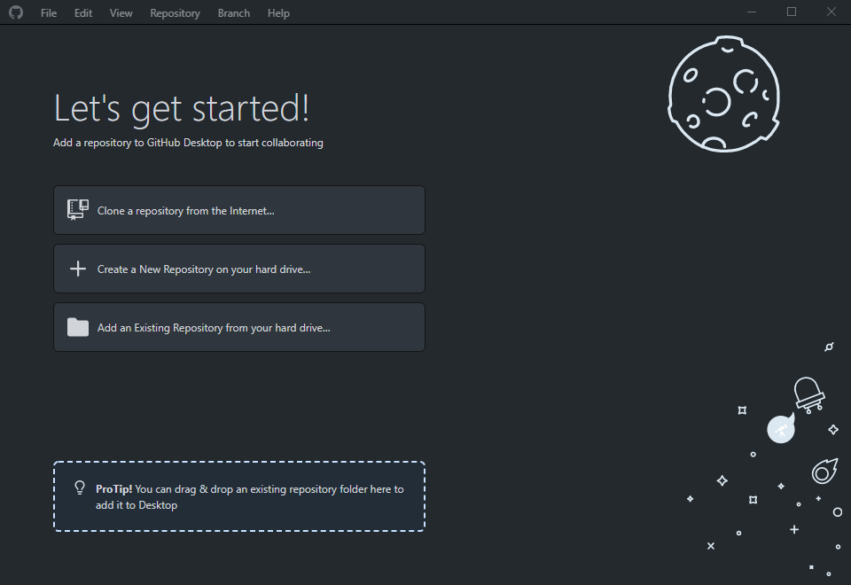
Cloning from GitHub
Figure 1

Slide 7
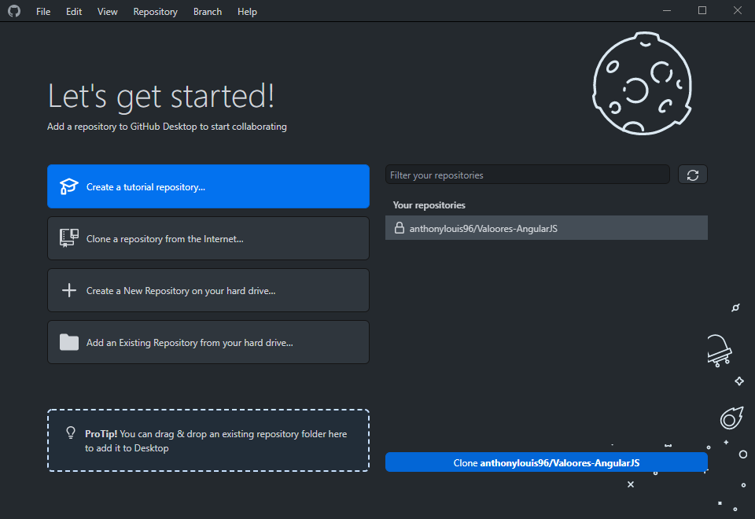
Cloning from GitHub
Figure 2

Slide 8
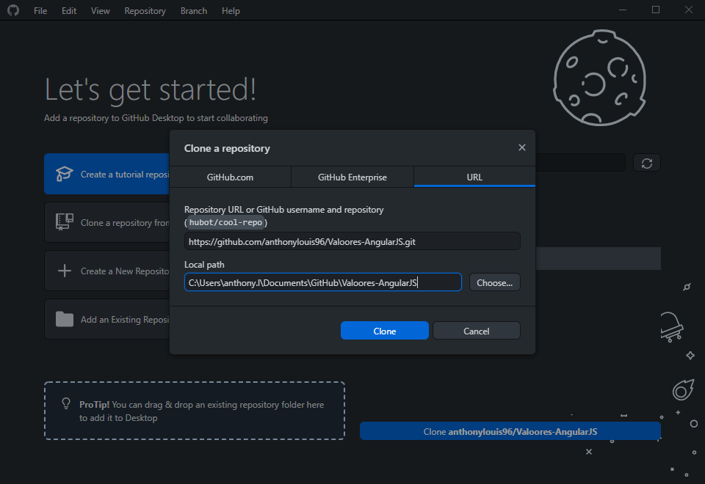
Cloning from GitHub
Figure 3

Slide 9
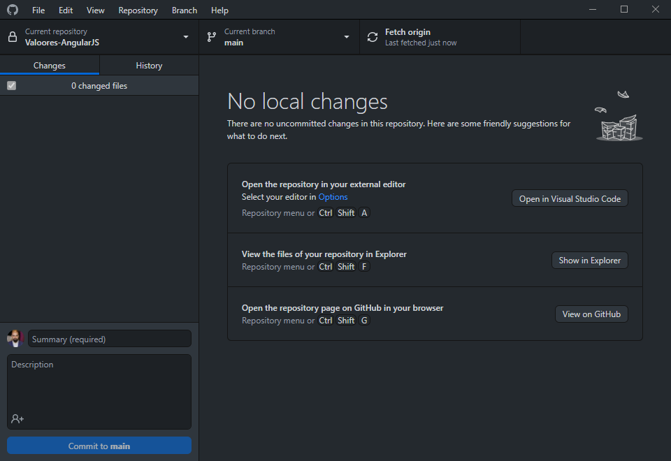
Cloning from GitHub
Figure 4

Slide 10
V21-5 General View

Slide 11
V21-5 What is angular
Angular is a development platform, built on Typescript.
As a platform, Angular includes:
A component-based framework for building scalable web applications
A collection of well-integrated libraries that cover a wide variety of features, including routing, forms management, client-server communication, and more
A suite of developer tools to help you develop, build, test, and update your code
Angular Development is based on Typescript, HTML, CSS, JSON in addition jQuery can be installed as well and used along side Typescript

Slide 12
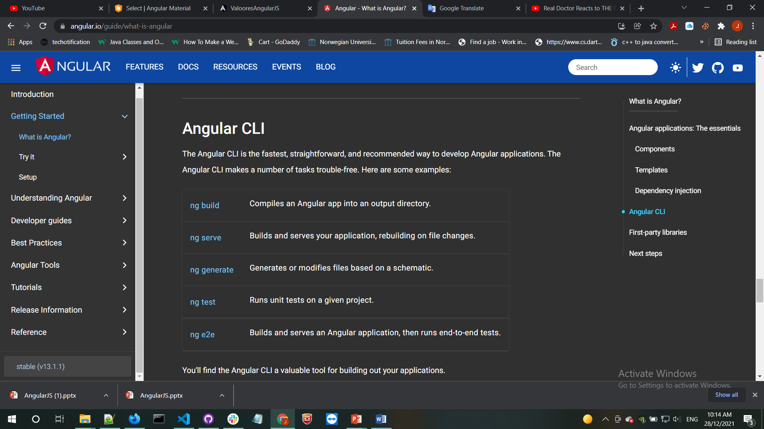
V21-5 Angular CLI
The commonly used commands in an Angular development

Slide 13
V21-5 What is TypeScript ?
Typescript is a strongly typed programming language that builds on JavaScript, giving you better tooling at any scale.
Browsers can't execute Typescript directly. Typescript must be “Transpiled" into JavaScript using the tsc compiler, that can be customized
npm install -g typescript

Slide 14
V21-5 DIRECTIVES
Directives are classes that add additional behavior to elements in your Angular applications. Use Angular's built-in directives to manage forms, lists, styles, and what users see
NgClass - adds and removes a set of CSS classes.
NgStyle - adds and removes a set of HTML styles
NgModel - adds two-way data binding to an HTML form element
NgIf - conditionally creates or disposes of subviews from the template
NgFor - repeat a node for each item in a list
NgSwitch - a set of directives that switch among alternative views

Slide 15
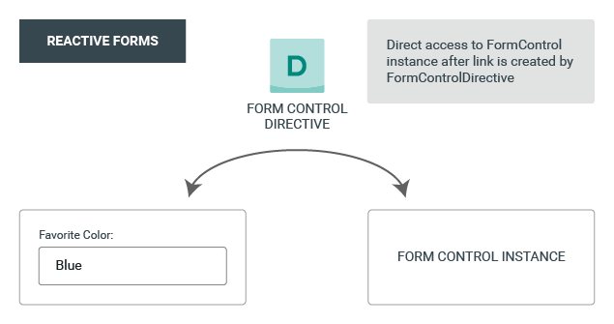
V21-5 Setting up reactive forms
FormControl: tracks the value and validation status of an individual form control.
FormGroup: tracks the same values and status for a collection of form controls.
FormArray: tracks the same values and status for an array of form controls.
ControlValueAccessor: creates a bridge between Angular FormControl instances and built-in DOM elements.

Slide 16
V21-5 Data flow in reactive forms
The model-to-view diagram shows how a programmatic change to the model is propagated to the view through the following steps.
The user calls the favoriteColorControl.setValue() method, which updates the FormControl value.
The FormControl instance emits the new value through the valueChanges observable.
Any subscribers to the valueChanges observable receive the new value.
The ControlValueAccessor on the form input element updates the element with the new value.

Slide 17
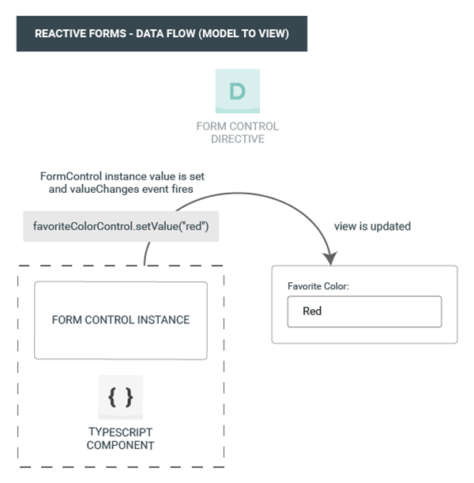
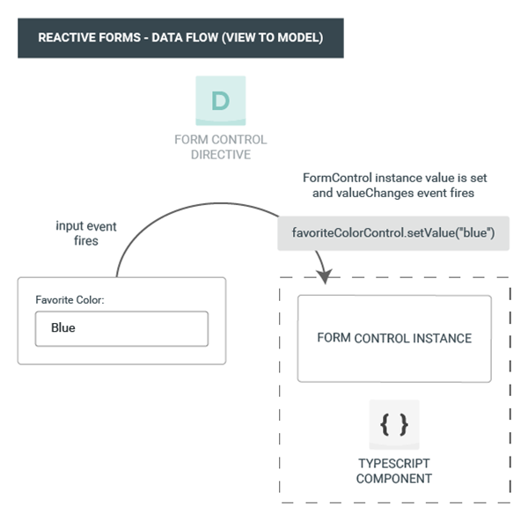
V21-5 Data flow in reactive forms

Slide 18
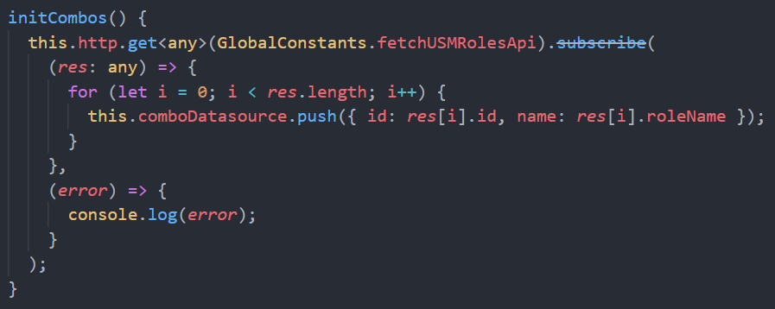
V21-5 Communicating with backend services using HTTP
Applications need to send and receive information with a Backend server through the http protocol to POST/GET/PUT/PATCH/DELETE data or access a service.
There’s a library called HttpClient for Angular applications that communicates with the Backend server using APIs

Slide 19
V21-5 Routing

Slide 20
V21-5 The Need for Routing
Usually we have different pages in a web application
How do we have different "pages" in a SPA(single Page Application)?
Load different components based on different URL
About
Component
Home
About
Login
Login
Component
HomeComponent
AppComponent

Slide 21
V21-5 Add A Routing Module
To create a module + routing
Run the following: ng g module <moduleName> –routing
It will generate a folder with <moduleName> containing
<moduleName>.routing.module.ts
<moduleName>.module.ts
Create a main html file that will hold the routing and add <router-outlet>
Notes:
Example:
AppRoutingModule :
import { NgModule } from '@angular/core';
import { Routes, RouterModule } from '@angular/router';
const routes: Routes = [];
@NgModule({
imports: [RouterModule.forRoot(routes)],
exports: [RouterModule]
})
export class AppRoutingModule { }

Slide 22
V21-5 Routes
Specify the mappings between paths and components, e.g.
Router Module
RouterModule.forRoot(routes) returns a RouterModule that is configured with routes
AppRoutingModule imports this module, then exports it so the rest of the application can use it
The forRoot() Conversion
forRoot() returns a module that should be imported by the root module
Use forChild() if you want to add routing to a feature module

Slide 23
V21-5 Wildcard Route
Catch un-matched routes and display a PageNotFound page (i.e. component)
Route order matters so make sure the wildcard route is listed last

Slide 24
V21-5 Dependency Injection
Create an injectable service use the following command
ng generate service <serviceName>
It will generate a service as shown in the next slide Figure 1
The @Injectable() decorator specifies that Angular can use this class in the DI system. The metadata, providedIn: 'root', means that the HeroService is visible throughout the application.
An example is shown in the next slide Figure 2

Slide 25
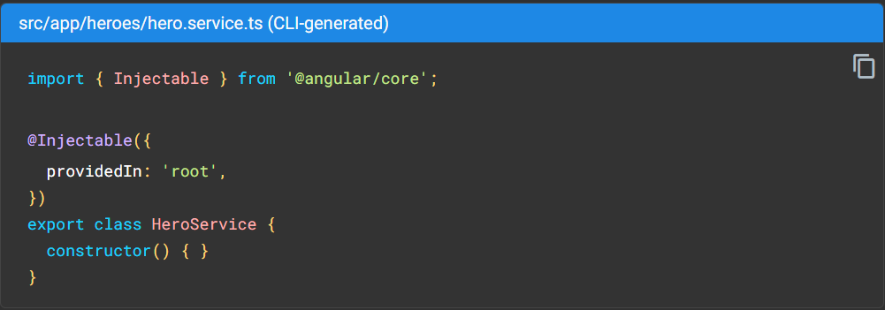
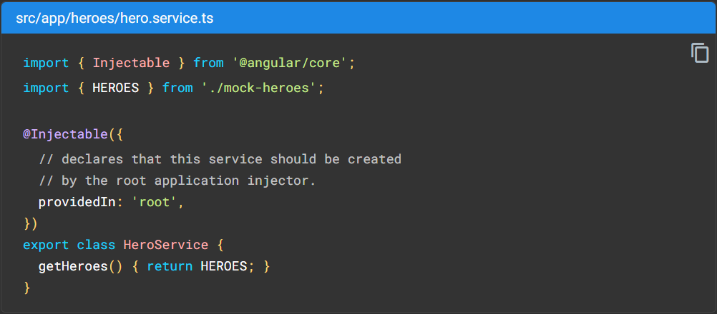
V21-5 Dependency Injection
Figure 1
Figure 2

Slide 26
V21-5 Redirect
To redirect to a component / page, in the routing add redirectTo:/<nameOfPage>, basically depending on the URL it will redirect to the specified page for example this can be used when checking if a wrong URL has been used to redirect to page not found.

Slide 27
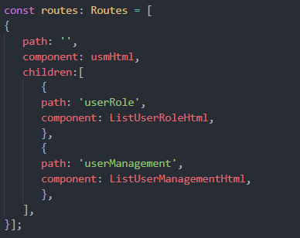
V21-5 Children Routes
The router lets you add child routes using the children property inside the routing module.

Slide 28
V21-5 Route Guard
Types of route guard
CanActivate: navigate to a route
CanActivateChild: navigate to a child route
CanDeactivate: navigate away from a route
CanLoad: used for lazy-loaded modules
Use the following command to generate a guard
ng g guard <guardName> then select the type of guard you whish to generate

Slide 29
Tips for Development Environment #1
Useful extension to download from Visual Studio Code Market for Angular Development
Angular Essentials (Version 12)
Angular Snippets (Version 12)
Nx Console
Npm
To refresh the node modules with the latest installed libraries in package.json in the project in case an update was done from the repository or in case of a failure
Delete node_modules folder
Run the npm install to redownload the libraries
For angular commands to work in Visual Studio Code use the following command in the Visual Studio Code Terminal
Set-ExecutionPolicy -Scope CurrentUser -ExecutionPolicy Unrestricted
For more references about angular
https://angular.io/

Slide 30
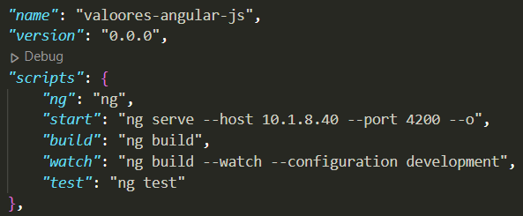
Tips for Development Environment #2
Angular project can be started with ng-server or npm it will take the local IP address as default 127.0.0.1:4200 in addition no one can see or access your local server at this point
To start Angular Project with specific host example: ng serve --host 10.1.8.40 this can also be configured in package.json under scripts/start to be taken automatically be aware to remove it from the package.json once you finish working and your about to commit.
To start Angular Project with a specific port example: ng serve --host 10.1.8.40 --port 5000 and can also be configured in package.json

Slide 31

Thank You

